Slide 1


RPA Essential Training Nanyang Polytechnic School of Information Technology

Slide 2

Need for Email Automation
What emails would you automate in your personal life? What about University or work?
Consider emails received as well as sent
Consider complexity vs. benefits
Take into account your personal life, the university and work
Notes:
When deciding on activities that you would select for automation, consider the complexity vs. benefits analysis
Complexity (number of steps, application types involved other than email, number of possible scenarios (if/else), input and output types (standard, structured or unstructured).
Benefit for this scenario (time savings, quality improvement/error reduction)
As a group, select two processes you find best suited for automation. These should include at least one with email as input and one with email as output and are ideally low effort/high benefits (Quick Wins). Towards the end of the course, you will find out how UiPath Studio activities could be used to automate these processes.

Slide 3



Introduction to Email Automation
To this day, many business processes are triggered by email or generate email output.
Estimates show that an average person spends between 5 and 11 hours a week checking, reading and responding to emails.
What can we automate?
Generating and sending automated messages
Retrieving messages and extracting data
Managing messages
Saving attachments
Saving messages
Notes:
With our examples in mind, let’s start looking at the key concepts of email automation.
Email is the oldest and most wide-spread form of business communication. A research by the Radicati Group, Inc. (https://www.radicati.com/wp/wp-content/uploads/2015/02/Email-Statistics-Report-2015-2019-Executive-Summary.pdf) shows that in 2018 the average number of business emails sent per day was 124.5 billion and the average number of consumer emails was 111.1 billion. Considering the 235.6 billion emails sent per day, we get an idea of the huge automation opportunity.
In a business context, many processes are triggered by email or generate some form of email output. Many of these processes could easily be automated.
On an individual level, consider how much time you spend reading and responding to emails. Could some of them be automated?

Slide 4
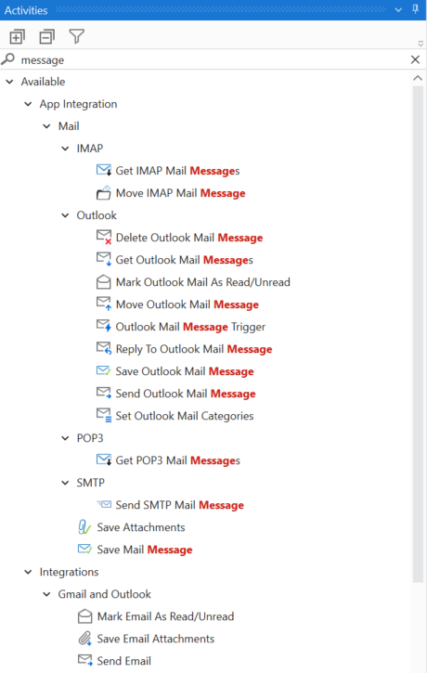
UiPath Studio Activities
UiPath Studio includes activities for sending, retrieving and organizing messages. The available categories are:
Generating and sending automated messages:
SMTP, Outlook and Exchange
Retrieving messages and extracting data:
POP3, Outlook, IMAP and Exchange
Managing Messages:
Outlook, IMAP, Exchange
Saving attachments and emails:
Generic Email Activities
Notes:
Let’s get better acquainted with how UiPath Studio helps you automate email messages.
The types of automation that can be applied to emails are:
Generating and sending automated messages
Retrieving messages and extracting data
Managing messages
Saving attachments and emails
Post office protocol, POP is one way with IMAP is 2 way and You can be logged in with multiple computers and devices simultaneously. Your mail archive is synced and stored on the server for all connected devices to access.

Slide 5


UiPath Studio Activities (Contd.)
Input via email
Names or ID numbers from the subject or body
Input files coming as attachments (.xls. .pdf)
Email as output
Progress reports
Exception alerts
Notes:
Before we start automating emails, we need to find out whether the email is an input or output for the activity, or it is both.
Input via email means the automation uses information from an incoming email. A few examples are grabbing the sender name from the “from” field, grabbing an ID number from the subject or body, counting the number of emails that meet the set criteria, downloading an attachment, and so on.
Email as output means the automation generates and sends an email according to the set rules. A few examples are sending a progress report at a set time based on an Excel file, sending an email notification when a process comes across an exception, responding to an email, and so on.

Slide 6

Simple Example - Retrieving Emails
Can you write an automation project in UiPath Studio to retrieve emails from Outlook and save attachments for the emails sent by teacher@address?

Slide 7

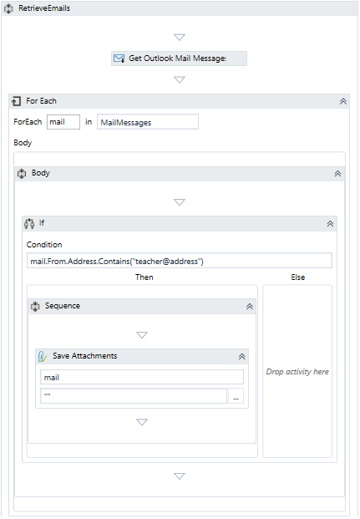
Retrieve and Save Emails from Outlook
Main steps of the solution
Get Outlook Mail Messages - Retrieve a set amount of emails from the Outlook inbox.
For each - Type of argument used is System.Net.Mail.MailMessage
If - The condition here is used to see if one of the emails in the list retrieved is from the teacher or not.
Inside the ‘If’ we have the Save Attachments activity, which saves the attachments from the email sent from the teacher. The attachments are saved in the local folder of the project.
Notes:
Note, this is not the only solution for this exercise. Let’s a have a look at the details for each activity.
Get Outlook Mail Message
Saves a set number of emails from Outlook in a variable.
Input > Mail folder: The email folder from which the messages are to be retrieved. For this example, use “Inbox”.
Options > Top: The number of messages to be retrieved starting from the top of the list.
Output > Messages: The variable in which you want to store the retrieved emails. The used variable type is List <Email Messages>
For Each:
Performs an operation for each object stored in the list variable
Misc > Type Argument: System.Net.Mail.MailMessage
Misc > Values: Use the output variable from the previous activity.
If:
Checks if the email “from” address contains teacher@address. If yes, it saves the attachment.
Condition > mail.From.Address.Contains(“teacher@address”)
The condition must be changed a little as it is dependent on a real email address, as a placeholder it's the used the "teacher@address".
Save Attachments:
Saves the attachments that meet the “If” criterion to the defined path.
Input > Folder Path: The full path of the folder where the attachments are to be saved.
Message > The MailMessage object whose attachments are to be saved.

Slide 8
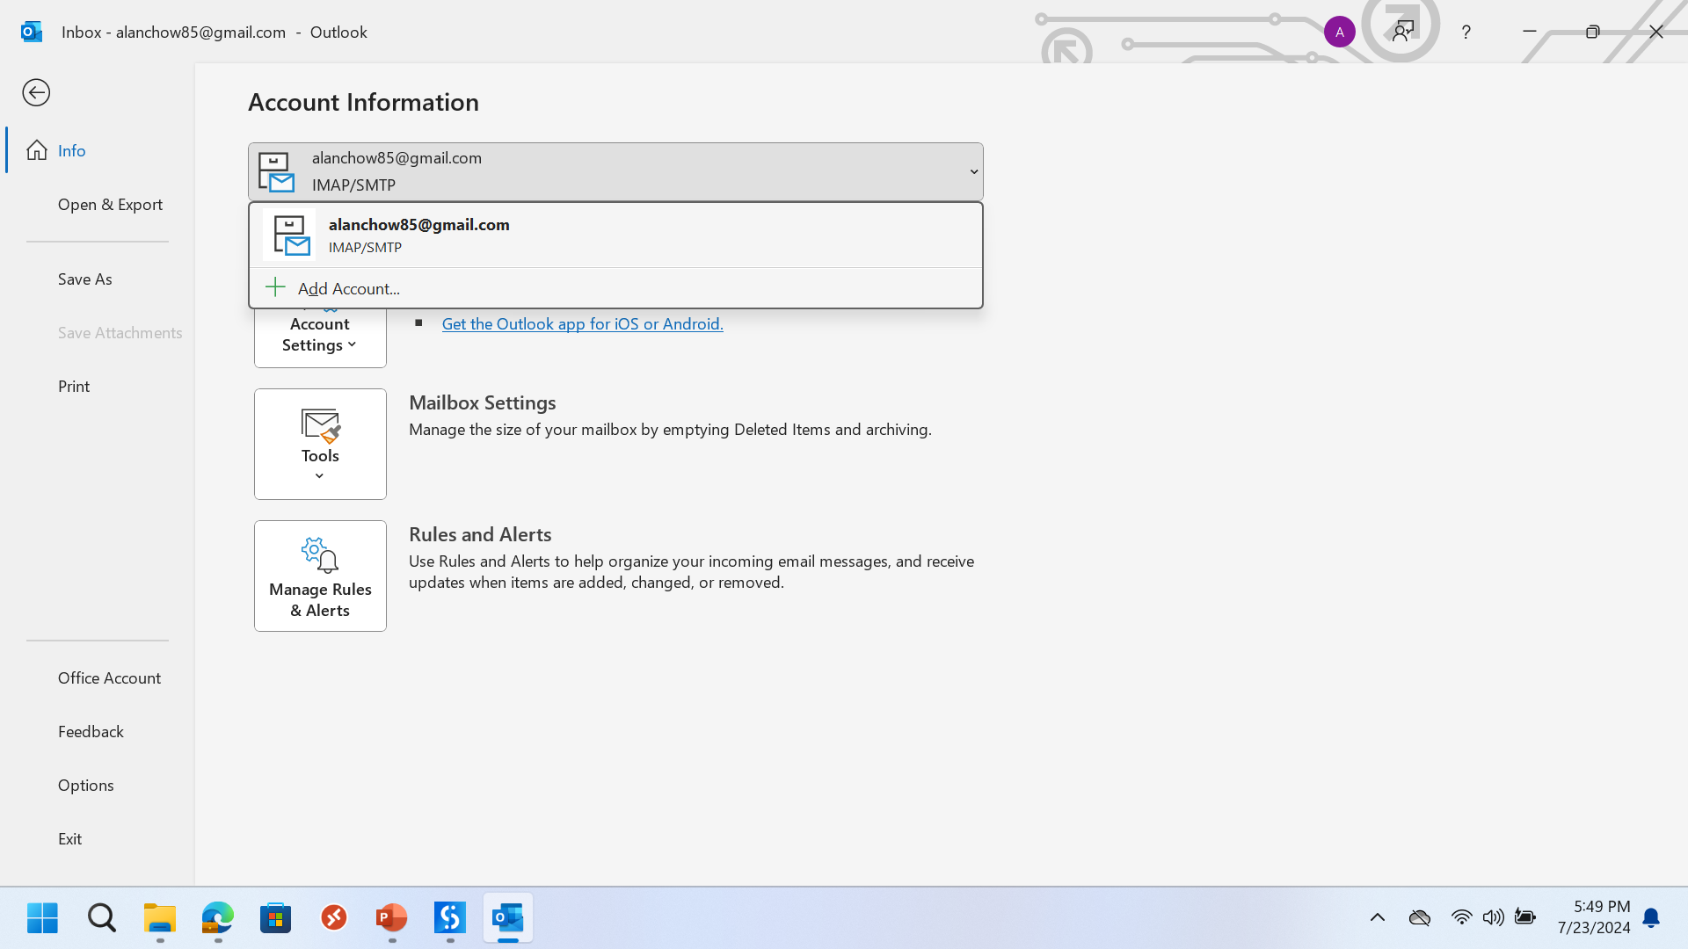

Slide 9
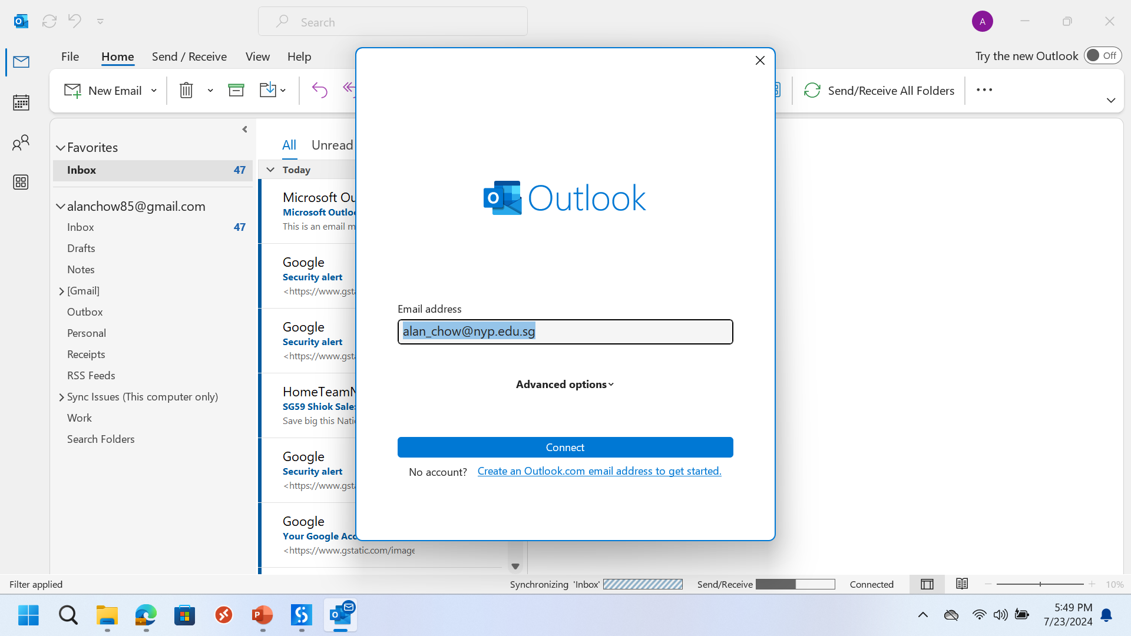

Slide 10
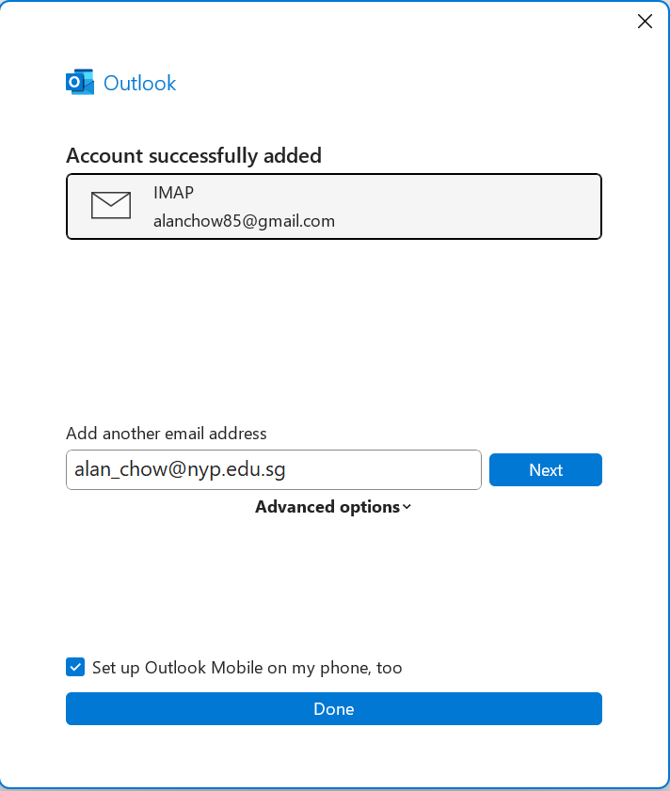

Slide 11

Email Functions
Audit case study

Slide 12
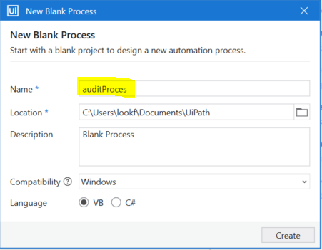

We will be using an Audit Process to learn how to use RPA.
Create a new Process Project named Audit Process
In the process you will learn:
Sending emails
Reading and download email attachments
Excel functions
Sends Audit confirmation emails to Auditees for bank amount confirmation
Auditees replies with email with confirmation of bank account amounts
Check for emails from Auditees and download attachments
FOR EACH email and attachment, add the bank amount and other details to the Audit excel file
Our first Robot will be sending out an email to Auditee

Slide 13
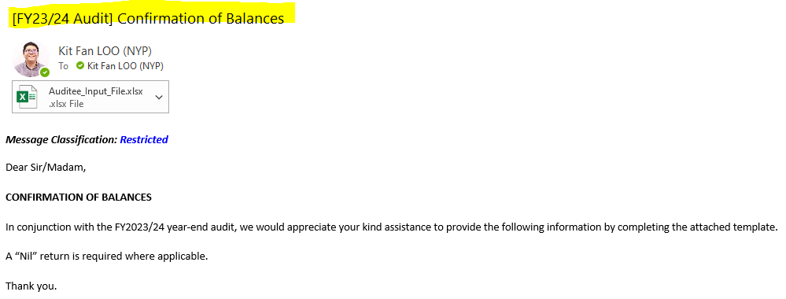
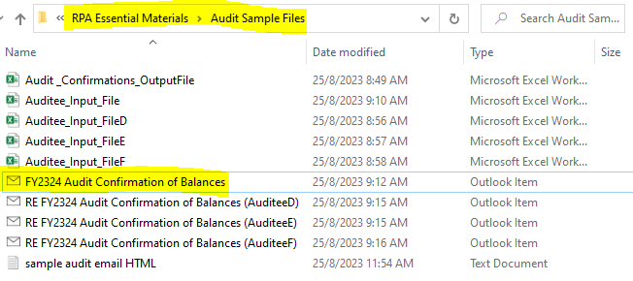
We will be sending this email to the auditee
For now we will learn how to send a single email. After you learnt more about read excel rows, you can try reading a list of email address from excel and using a loop to send multiple emails.
The sample email can be found in the Audit Sample Files folder

Slide 14
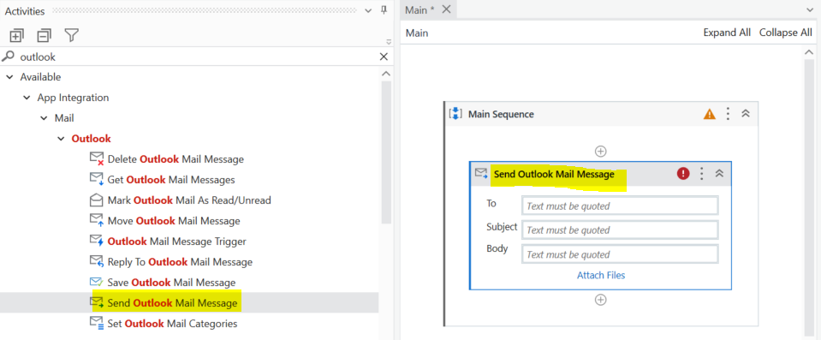
Sends Audit confirmation emails to Auditees for bank amount confirmation
Auditees replies with email with confirmation of bank account amounts
Check for emails from Auditees and download attachments
FOR EACH email and attachment, add the bank amount and other details to the Audit excel file
Search for Outlook and drag Send Outlook Mail to the Main Sequence.

Slide 15
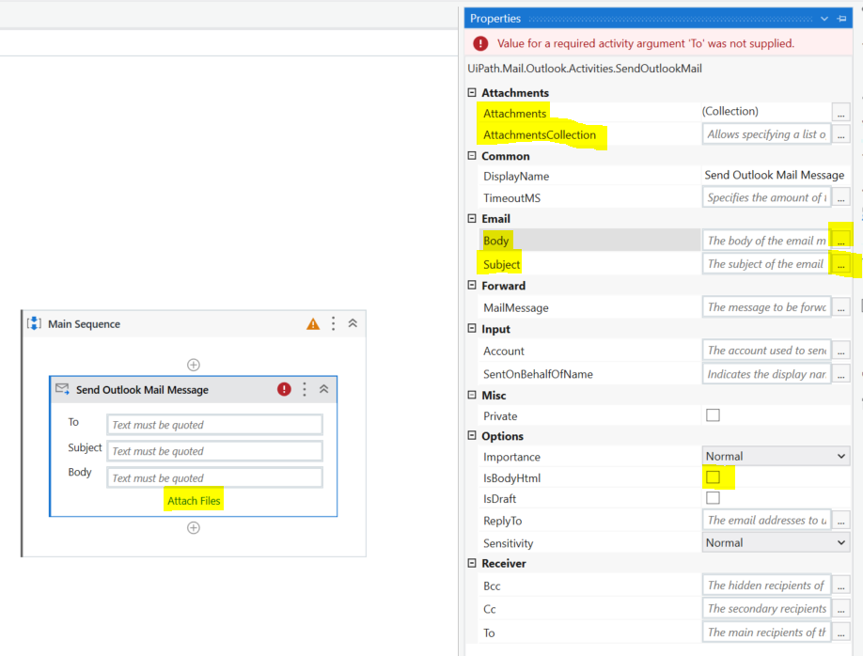
IMPORTANT→ Click on the Send Outlook Mail activity and go to the property panel on the right.
Property panel allows you to update information, add text to email body and other important properties of the email
Attachments → Can add filePaths to attachments
Body → The body Text of the email, preferably in HTML
Subject → Email subject text
IsBodyHTML → Check it so that you can format your email properly
IsDraft → Set this to checked first so email will be send to draft folder instead.

Slide 16
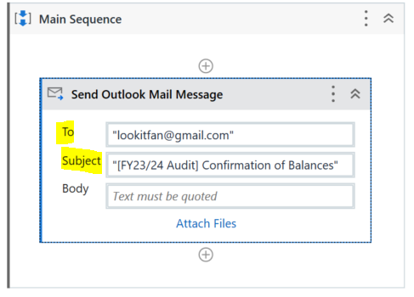
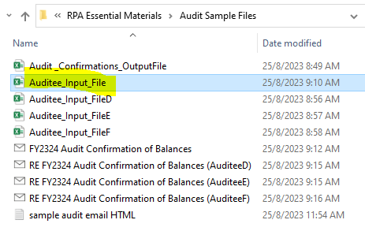
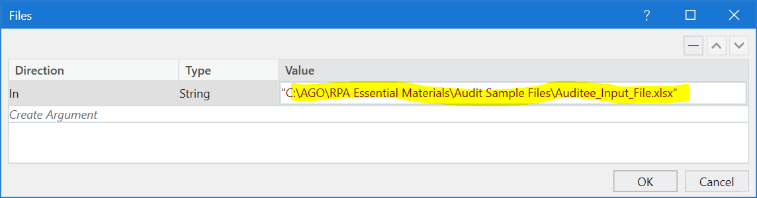
1) Add Email Subject and To email address
In the Subject field, type →
"[FY23/24 Audit] Confirmation of Balances“
In the To field, type →
"lookitfan@gmail.com"
Please note that you can also updated these values in the property panel
2) Add Attachment file for Excel
Type in the path to the Auditee_input_File.xlsx in the Value. This will attach the file into the email
Select “Attach Files”

Slide 17
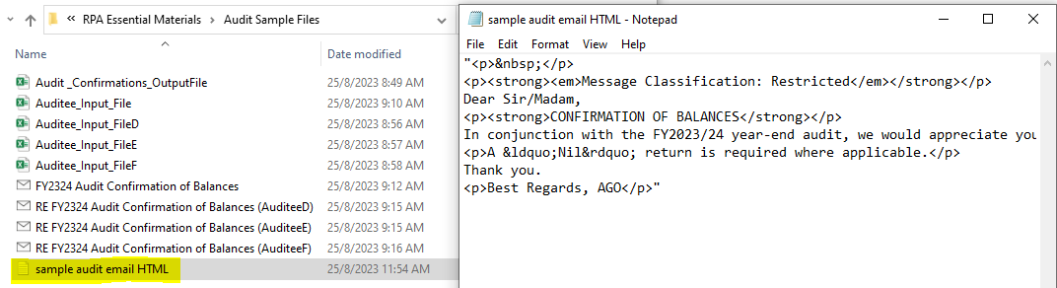
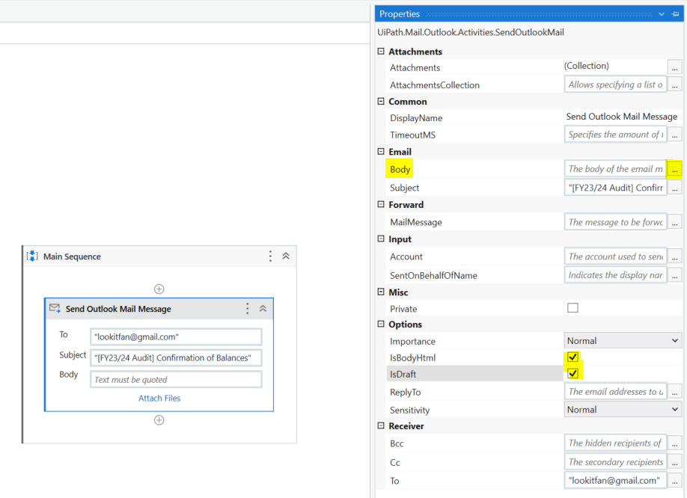
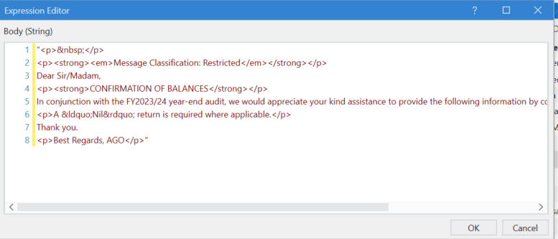
3) Add Email body to email
1) Open the sample audit email HTML text file, and open the text inside the file
4) Click on the Body 3 Dots to open the bigger window for email body.
5) Paste HTML email body into the editor. Click OK.
2) Check the IsBodyHTML option to yes.
3) Check the IsDraft option to yes.
Run your program to test. The email will be in your Outlook Draft Folder

Slide 18
Email Functions
Adding sample emails to Outlook folder
Downloading email attachments

Slide 19
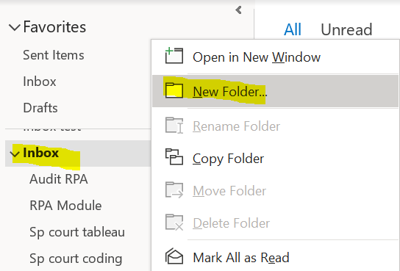

Sends Audit confirmation emails to Auditees for bank amount confirmation
Auditees replies with email with confirmation of bank account amounts
Check for emails from Auditees and download attachments
FOR EACH email and attachment, add the bank amount and other details to the Audit excel file
Our second process extract emails from Outlook and download attachments
To simulate receiving replied emails form Auditees, we will have to create a mail folder in Inbox.
Right Click the Inbox in your Outlook and select New Folder. Name the new Folder Audit RPA.
New Mail Folder created called Audit RPA inside Inbox.
This is where we add in the sample received emails form auditees.

Slide 20
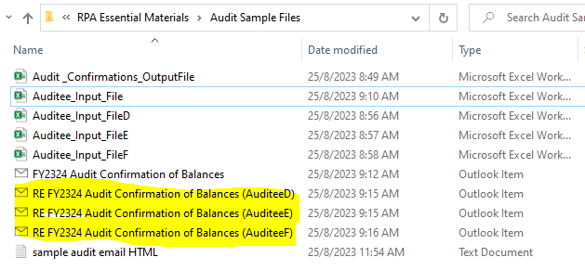
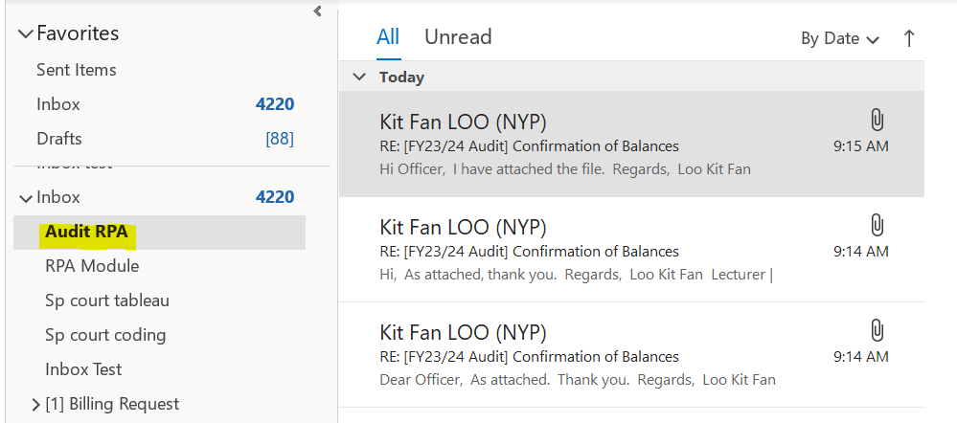
Sends Audit confirmation emails to Auditees for bank amount confirmation
Auditees replies with email with confirmation of bank account amounts
Check for emails from Auditees and download attachments
FOR EACH email and attachment, add the bank amount and other details to the Audit excel file
Drag the 3 sample emails into your Audit RPA email folder.
Once done, we will start to read the emails and download the attachments!

Slide 21
Email Functions
Adding sample emails to Outlook folder
Downloading email attachments

Slide 22
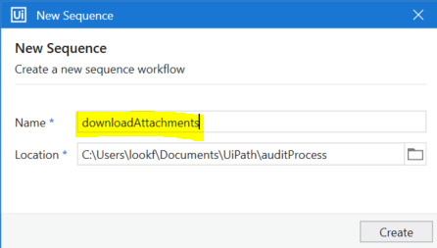
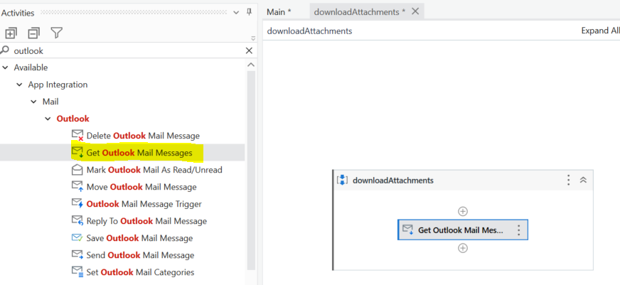
Sends Audit confirmation emails to Auditees for bank amount confirmation
Auditees replies with email with confirmation of bank account amounts
Check for emails from Auditees and download attachments
FOR EACH email and attachment, add the bank amount and other details to the Audit excel file
Add a new Sequence XAML file named downloadAttachment to the project.
Design→ New → Sequence
Search for Outlook and Add a Get Outlook Mail Messages activity to the sequence. This will help us get the list of emails from the folder we want.

Slide 23
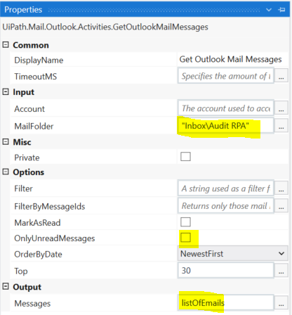
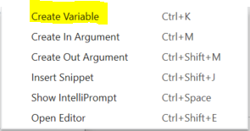
Go to the property panel:
The most important are: Account, MailFolder and MailMessages. Without these properties the activity will not work.
Account: Can leave as blank, or add the email address that you wish to access in Outlook. Blank will default to the main account.
MailFolder: Generally you will grab your emails from "Inbox", but you could also place there any folder from your Outlook application.
Output →Messages: The easiest way is to press right click in the blank space ( or Ctrl+K ) to create the output variable which is a list of MailMessages.
Account→ Blank
MailFolder→ Type: "Inbox\Audit RPA"
OnlyUnreadMessages→ Uncheck
Select the text box →
Right click →
select Create Variable→
listOfEmails

Slide 24
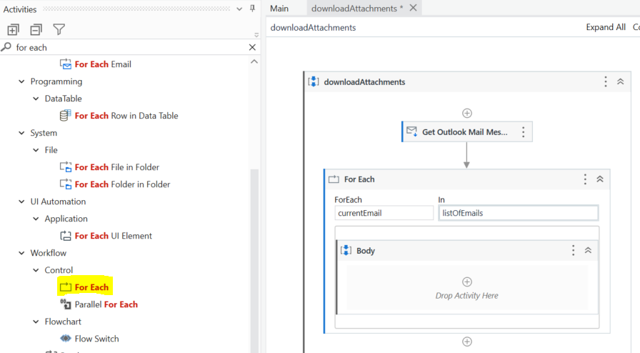
We will now loops through the emails using For Each Loop
Change the name from currentItem to currentEmail for easier reference later
Make sure your are looping the list of emails.
Update this to listOfEmails (the same variable that retrieve our emails in the previous step.
Search for For Each and Add a Workflow→ Control→ For Each activity to the sequence. This will help us loop through the emails.

Slide 25
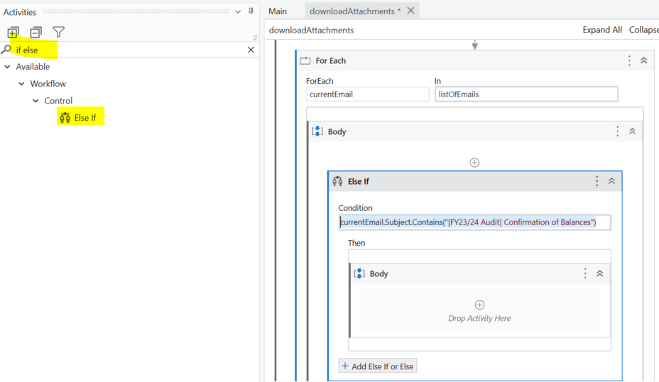
We will now create filter that checks if email subject contains “[FY23/24 Audit] Confirmation of Balances”
Remember, we only want to download attachments form these types of emails!
Update the condition to:
currentEmail.Subject.Contains("[FY23/24 Audit] Confirmation of Balances")
This will mean that ONLY emails containing this text will proceed to the Body of the IF ELSE.
If the email subject is different, it will not proceed.
Search for IF ELSE and add the activity to the Body of the For Each.

Slide 26
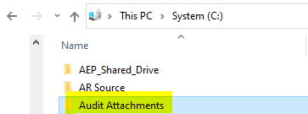
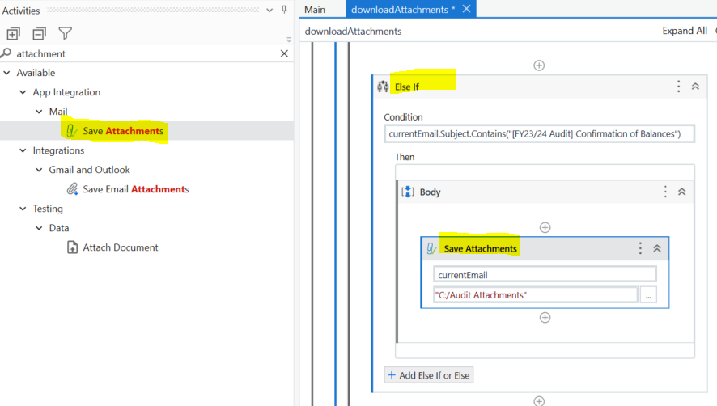
We will now proceed to download the attachments from the email.
As default, we can create a Audit Attachments folder in C:/ as the location to download attachments
Update this to currentEmail
Update this to
"C:/Audit Attachments"
Search for attachments and Add a Save Attachment activity to the sequence. This will help us loop through the emails.
Run your program to test. You will find the attachments in your C:/ folder.

